Slide 1
IT 356: Introduction To Computer Graphics (Lecture 12)
School of Information Technology
Illinois State University
Dr. Qi Zhang, Spring 2024

Slide 2
VBO, VAO, and Shader Program ID
//Vertex Buffer Object (VBO)
unsigned int VBO;
//Vertex Array Object (VAO)
unsigned int VAO;
//Shader Program (shaderProgram)'s ID
unsigned int shaderProgram;
//Generate VAO and VBO
glGenVertexArrays(1, &VAO);
glGenBuffers(1, &VBO);
//Return shaderProgram, which is used to set the shader program's ID
shaderProgram = loadShader("../../src/shader/texture1.vert",
"../../src/shader/texture1.frag");

Slide 3
Display Window Ratio
//Display window ratio
float ratio;
//Compute the ratio for the display window
ratio = (float)nHeight / (float)nWidth;

Slide 4
Setup Vertex Data
//Set up vertex data (and buffer(s)) and configure vertex attributes
float vertices[] = {
//positions //colors //textures
-0.5f * ratio, -0.5f, 0.0f, 0.0f, 1.0f, 0.0f, 0.0f, 0.0f, //lower-left corner
0.5f * ratio, -0.5f, 0.0f, 1.0f, 0.0f, 0.0f, 1.0f, 0.0f, //lower-right corner
0.0f, 0.5f, 0.0f, 0.0f, 0.0f, 1.0f, 0.5f, 1.0f //top-center conrner
};

Slide 5
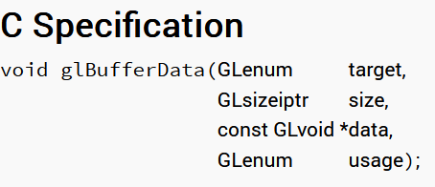
Bind VAO, VBO to Array Buffer
//Bind VAO and VBO to array buffer
glBindVertexArray(VAO);
glBindBuffer(GL_ARRAY_BUFFER, VBO);
glBufferData(GL_ARRAY_BUFFER, sizeof(vertices), vertices, GL_STATIC_DRAW);
Create and initialize a buffer object's data store

Slide 6
The glBufferData Function
target: Specifies the target buffer object. The symbolic constant must be GL_ARRAY_BUFFER, GL_ELEMENT_ARRAY_BUFFER
size: Specifies the buffer object's new data store size in bytes.
data: Specifies a pointer to data that will be copied into the data store for initialization, or NULL if no data is to be copied.
usage: Specifies the expected usage pattern of the data store. The symbolic constant must be GL_STREAM_DRAW, GL_STREAM_READ, GL_STREAM_COPY, GL_STATIC_DRAW, GL_STATIC_READ, GL_STATIC_COPY, GL_DYNAMIC_DRAW, GL_DYNAMIC_READ, or GL_DYNAMIC_COPY.

Slide 7
The glBufferData: Introduction
glBufferData creates a new data store for the buffer object currently bound to the target.
Any pre-existing data store is deleted.
The new data store is created with the specified size in bytes and usage.
If data is not NULL, the data store is initialized with data from this pointer.
In its initial state, the new data store is not mapped; it has a NULL mapped pointer, and its mapped access is GL_READ_WRITE.

Slide 8
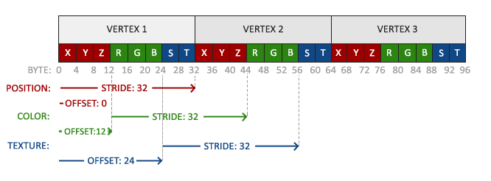
Load Data Using Attribute Pointer
//Position attribute
glVertexAttribPointer(0, 3, GL_FLOAT, GL_FALSE, 8 * sizeof(float), (void*)0);
glEnableVertexAttribArray(0);
//Color attribute
glVertexAttribPointer(1, 3, GL_FLOAT, GL_FALSE, 8 * sizeof(float), (void*)(3 * sizeof(float)));
glEnableVertexAttribArray(1);
//Texture coord attribute
glVertexAttribPointer(2, 2, GL_FLOAT, GL_FALSE, 8 * sizeof(float), (void*)(6 * sizeof(float)));
glEnableVertexAttribArray(2);

Slide 9
Texture Units
//Texture units: texture1 and texture2
unsigned int texture1, texture2;

Slide 10
Generate and Load Texture1
//Generate and bind texture1
glGenTextures(1, &texture1);
glBindTexture(GL_TEXTURE_2D, texture1);
//Set the texture wrapping parameters
//Set texture wrapping to GL_REPEAT (default wrapping method)
glTexParameteri(GL_TEXTURE_2D, GL_TEXTURE_WRAP_S, GL_REPEAT);
glTexParameteri(GL_TEXTURE_2D, GL_TEXTURE_WRAP_T, GL_REPEAT);
//Set texture filtering parameters
glTexParameteri(GL_TEXTURE_2D, GL_TEXTURE_MIN_FILTER, GL_LINEAR);
glTexParameteri(GL_TEXTURE_2D, GL_TEXTURE_MAG_FILTER, GL_LINEAR);

Slide 11
Load Image and Create Texture1
//load image, create texture, and generate mipmaps
int width, height, nrChannels;
//Tell stb_image.h to flip loaded textures on the y-axis.
stbi_set_flip_vertically_on_load(true);
unsigned char *data = stbi_load("../../src/resources/textures/wall.jpg",
&width, &height, &nrChannels, 0);
if (data)
{
glTexImage2D(GL_TEXTURE_2D, 0, GL_RGB, width, height, 0, GL_RGB, GL_UNSIGNED_BYTE, data);
glGenerateMipmap(GL_TEXTURE_2D);
}
else
{
std::cout << "Failed to load texture" << std::endl;
}
stbi_image_free(data);

Slide 12
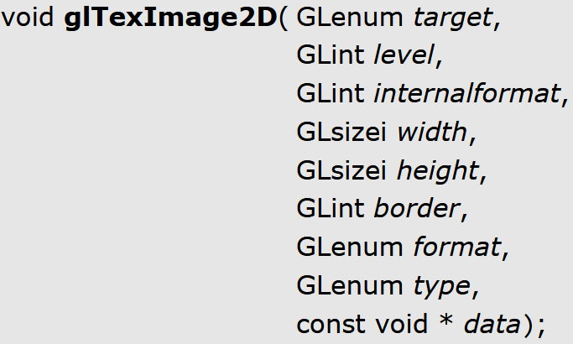
The glTexImage2D Function
glTexImage2D — specify a two-dimensional texture image
https://registry.khronos.org/OpenGL-Refpages/gl4/html/glTexImage2D.xhtml
glTexImage2D(GL_TEXTURE_2D, 0, GL_RGB,
width, height, 0, GL_RGB,
GL_UNSIGNED_BYTE, data);

Slide 13
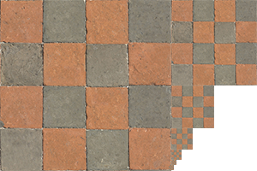
The glGenerateMipmap Function
void glGenerateMipmap( GLenum target)
glGenerateMipmap generates mipmaps for the specified texture object.
The texture object that is bound to the target.
glGenerateMipmap(GL_TEXTURE_2D);

Slide 14
Generate and Load Texture2
//Generate and bind texture 2
glGenTextures(1, &texture2);
glBindTexture(GL_TEXTURE_2D, texture2);
//Set the texture wrapping parameters
//Set texture wrapping to GL_REPEAT (default wrapping method)
glTexParameteri(GL_TEXTURE_2D, GL_TEXTURE_WRAP_S, GL_REPEAT);
glTexParameteri(GL_TEXTURE_2D, GL_TEXTURE_WRAP_T, GL_REPEAT);
//Set texture filtering parameters
glTexParameteri(GL_TEXTURE_2D, GL_TEXTURE_MIN_FILTER, GL_LINEAR);
glTexParameteri(GL_TEXTURE_2D, GL_TEXTURE_MAG_FILTER, GL_LINEAR);

Slide 15
Load Image and Create Texture2
//Load image, create texture, and generate mipmaps
data = stbi_load("../../src/resources/textures/awesomeface.png", &width, &height, &nrChannels, 0);
if (data)
{
//note that the awesomeface.png has transparency and thus an alpha channel,
//so, make sure to tell OpenGL the data type is of GL_RGBA
glTexImage2D(GL_TEXTURE_2D, 0, GL_RGBA, width, height, 0, GL_RGBA, GL_UNSIGNED_BYTE, data);
glGenerateMipmap(GL_TEXTURE_2D);
}
else
{
std::cout << "Failed to load texture" << std::endl;
}
stbi_image_free(data);

Slide 16
Sampler Texture Unit Belongs To
//Tell OpenGL for each sampler to which texture unit it belongs to
//(only has to be done once)
glUseProgram(shaderProgram);
glUniform1i(glGetUniformLocation(shaderProgram, "texture1"), 0);
glUniform1i(glGetUniformLocation(shaderProgram, "texture2"), 1);

Slide 17
Vertex Shader: texture0.vert
#version 460 core
layout (location = 0) in vec3 aPos;
layout (location = 1) in vec3 aColor;
layout (location = 2) in vec2 aTexCoord;
out vec3 ourColor;
out vec2 TexCoord;
void main()
{
gl_Position = vec4(aPos, 1.0);
ourColor = aColor;
TexCoord = vec2(aTexCoord.x, aTexCoord.y);
}
we need to alter the vertex shader to accept the texture coordinates as a vertex attribute
Then, forward the coordinates to the fragment shader

Slide 18
Fragment Shader: texture0.frag
#version 460 core
out vec4 FragColor;
in vec3 ourColor;
in vec2 TexCoord;
//Texture samplers
uniform sampler2D texture1;
uniform sampler2D texture2;
void main()
{
// linearly interpolate between both textures (80% wall, 20% Awesomeface)
FragColor = mix(texture(texture1, TexCoord), texture(texture2, TexCoord), 0.2);
}
The fragment shader should also have access to the texture object, but how do we pass the texture object to the fragment shader?

Slide 19
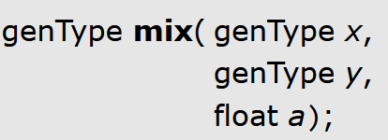
The mix function in GLSL
mix — linearly interpolate between two values
mix performs a linear interpolation between x and y using a to weight between them. The return value is computed as x×(1−a)+y×a.
x: Specify the start of the range in which to interpolate.
y: Specify the end of the range in which to interpolate.
a: Specify the value to interpolate between x and y.

Slide 20
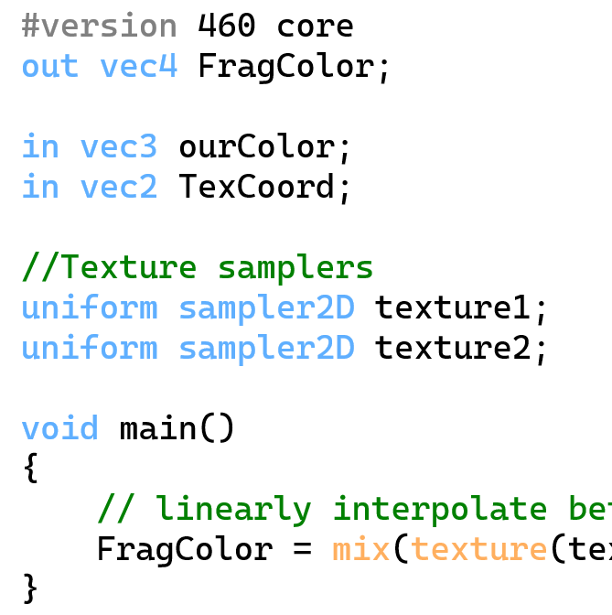
Bind Texture and Draw Container
//Bind textures on corresponding texture units
//Activate the texture unit first before binding the texture
glActiveTexture(GL_TEXTURE0);
glBindTexture(GL_TEXTURE_2D, texture1);
glActiveTexture(GL_TEXTURE1);
glBindTexture(GL_TEXTURE_2D, texture2);
//Render container
glUseProgram(shaderProgram);
glBindVertexArray(VAO);
glDrawArrays(GL_TRIANGLES, 0, 3);

Slide 21
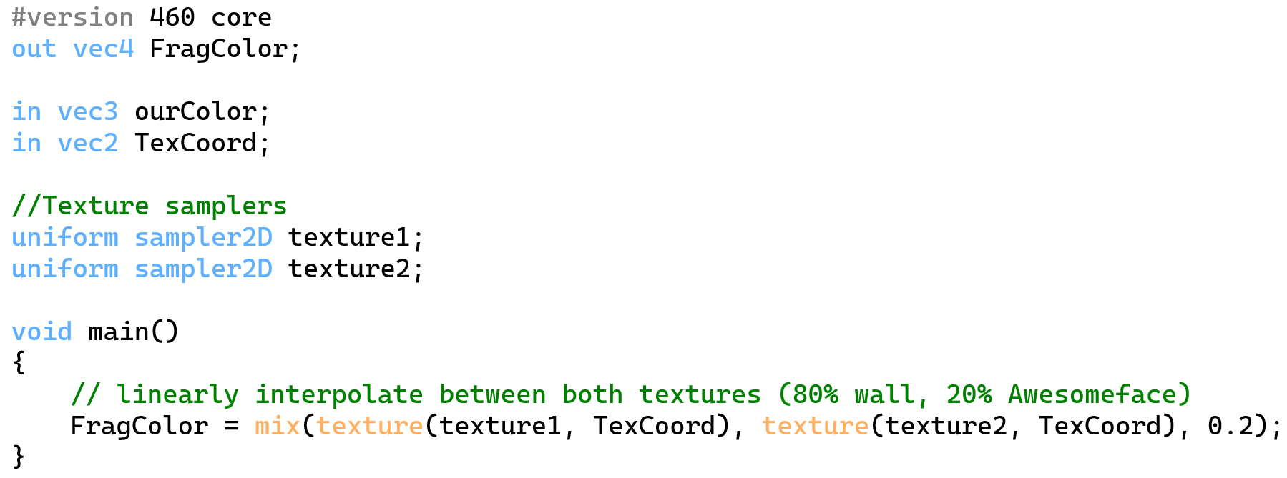
Applying Textures
GLSL has a built-in data type for texture objects called a sampler that takes as a postfix the texture type, we want, e.g., sampler1D, sampler3D, or, in our case, sampler2D.
We can then add a texture to the fragment shader by declaring a uniform sampler2D to which we later assign our texture.

Slide 22
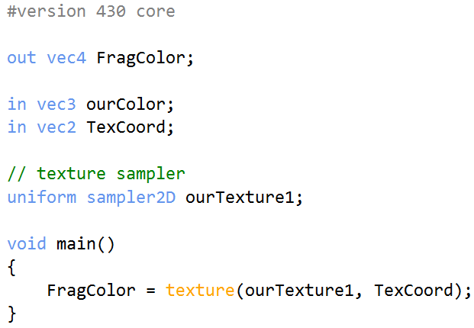
Applying Textures
To sample the color of a texture, we use GLSL's built-in texture function that takes as its first argument a texture sampler and as its second argument the corresponding texture coordinate.
GLSL's built-in texture function
fragment shader

Slide 23
De-Allocate All Resources
//Optional: de-allocate all resources once they've outlived their purpose:
glDeleteVertexArrays(1, &VAO);
glDeleteBuffers(1, &VBO);

Slide 24
Framebuffer Size Callback
//Set framebuffer_size_callback function using glfw
glfwSetFramebufferSizeCallback(window, framebuffer_size_callback);
//Make sure the viewport matches the new window dimensions; note that the width and
//height will be significantly larger than specified on retina displays.
glViewport(0, 0, width, height);
ratio = (float)height / (float)width;
//set up vertex data (and buffer(s)) and configure vertex attributes
float vertices[] = {
//positions //colors //textures
-0.5f * ratio, -0.5f, 0.0f, 0.0f, 1.0f, 0.0f, 0.0f, 0.0f, //lower-left corner
0.5f * ratio, -0.5f, 0.0f, 1.0f, 0.0f, 0.0f, 1.0f, 0.0f, //lower-right corner
0.0f, 0.5f, 0.0f, 0.0f, 0.0f, 1.0f, 0.5f, 1.0f //top-center corner
};
//Recreate the buffer data store using vertices
glBufferData(GL_ARRAY_BUFFER, sizeof(vertices), vertices, GL_STATIC_DRAW);

Slide 25
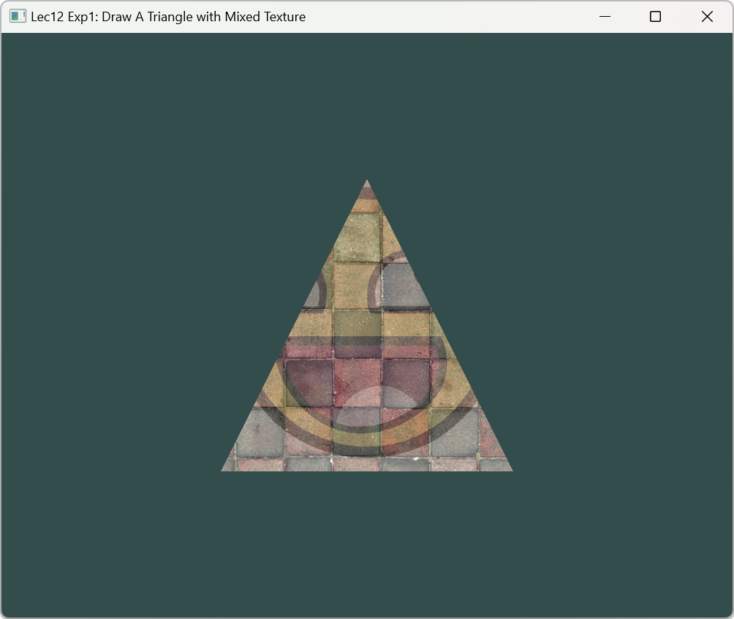
Running Result

Slide 26
VBO, VAO, and EBO
//Vertex Buffer Object (VBO)
unsigned int VBO;
//Vertex Array Object (VAO)
unsigned int VAO;
//Element Buffer Objects (EBO)
unsigned int EBO;
//Generate VAO, VBO, and EBO
glGenVertexArrays(1, &VAO);
glGenBuffers(1, &VBO);
glGenBuffers(1, &EBO);

Slide 27
Shader Program
//Shader Program (shaderProgram)'s ID
unsigned int shaderProgram;
//Return shaderProgram, which is used to set the shader program's ID
shaderProgram = loadShader("../../src/shader/texture2.vert",
"../../src/shader/texture2a.frag");

Slide 28
Display Ratio of Display Window
//Display ratio of the display window
float ratio;
//Calculate the display ratio
ratio = (float)nHeight / (float)nWidth;

Slide 29
Setup Vertex Data
//Set up vertex data (and buffer(s)) and configure vertex attributes
float vertices[] = {
//positions //colors //textures
0.5f * ratio, 0.5f, 0.0f, 1.0f, 0.0f, 0.0f, 1.0f, 1.0f, // top right
0.5f * ratio, -0.5f, 0.0f, 0.0f, 1.0f, 0.0f, 1.0f, 0.0f, // bottom right
-0.5f * ratio, -0.5f, 0.0f, 0.0f, 0.0f, 1.0f, 0.0f, 0.0f, // bottom left
-0.5f * ratio, 0.5f, 0.0f, 1.0f, 1.0f, 0.0f, 0.0f, 1.0f // top left
};
unsigned int indices[] = {
0, 1, 3, // first triangle
1, 2, 3 // second triangle
};

Slide 30
Bind VAO, VBO, and EBO to Array Buffer
//Bind VAO, VBO, and EBO to array buffer
//Create and initialize a buffer object's data store for VBO and EBO
//by loading vertices and indices to graphics memory
glBindVertexArray(VAO);
glBindBuffer(GL_ARRAY_BUFFER, VBO);
glBufferData(GL_ARRAY_BUFFER, sizeof(vertices), vertices, GL_STATIC_DRAW);
glBindBuffer(GL_ELEMENT_ARRAY_BUFFER, EBO);
glBufferData(GL_ELEMENT_ARRAY_BUFFER, sizeof(indices), indices, GL_STATIC_DRAW);

Slide 31
Load Data Using Attribute Pointer
//Load data using attribute pointer
//Position attribute
glVertexAttribPointer(0, 3, GL_FLOAT, GL_FALSE, 8 * sizeof(float), (void*)0);
glEnableVertexAttribArray(0);
//Color attribute
glVertexAttribPointer(1, 3, GL_FLOAT, GL_FALSE, 8 * sizeof(float), (void*)(3 * sizeof(float)));
glEnableVertexAttribArray(1);
//Texture coord attribute
glVertexAttribPointer(2, 2, GL_FLOAT, GL_FALSE, 8 * sizeof(float), (void*)(6 * sizeof(float)));
glEnableVertexAttribArray(2);

Slide 32
Generate and Bind Texture1
//Generate and bind texture1
glGenTextures(1, &texture1);
glBindTexture(GL_TEXTURE_2D, texture1);
//Set the texture wrapping parameters
//Set texture wrapping to GL_REPEAT (default wrapping method)
glTexParameteri(GL_TEXTURE_2D, GL_TEXTURE_WRAP_S, GL_REPEAT);
glTexParameteri(GL_TEXTURE_2D, GL_TEXTURE_WRAP_T, GL_REPEAT);
//Set texture filtering parameters
glTexParameteri(GL_TEXTURE_2D, GL_TEXTURE_MIN_FILTER, GL_LINEAR);
glTexParameteri(GL_TEXTURE_2D, GL_TEXTURE_MAG_FILTER, GL_LINEAR);

Slide 33
Load Image and Create Texture
//Load image, create texture, and generate mipmaps
int width, height, nrChannels;
//Tell stb_image.h to flip loaded texture's on the y-axis.
stbi_set_flip_vertically_on_load(true);
unsigned char *data = stbi_load("../../src/resources/textures/wall.jpg", &width, &height, &nrChannels, 0);
if (data)
{
glTexImage2D(GL_TEXTURE_2D, 0, GL_RGB, width, height, 0, GL_RGB, GL_UNSIGNED_BYTE, data);
glGenerateMipmap(GL_TEXTURE_2D);
}
else
{
std::cout << "Failed to load texture" << std::endl;
}
stbi_image_free(data);

Slide 34
Generate and Bind Texture2
//Generate and bind texture2
glGenTextures(1, &texture2);
glBindTexture(GL_TEXTURE_2D, texture2);
//set the texture wrapping parameters
//set texture wrapping to GL_REPEAT (default wrapping method)
glTexParameteri(GL_TEXTURE_2D, GL_TEXTURE_WRAP_S, GL_REPEAT);
glTexParameteri(GL_TEXTURE_2D, GL_TEXTURE_WRAP_T, GL_REPEAT);
//set texture filtering parameters
glTexParameteri(GL_TEXTURE_2D, GL_TEXTURE_MIN_FILTER, GL_LINEAR);
glTexParameteri(GL_TEXTURE_2D, GL_TEXTURE_MAG_FILTER, GL_LINEAR);

Slide 35
Load Image and Create Texture
//load image, create texture, and generate mipmaps
data = stbi_load("../../src/resources/textures/awesomeface.png", &width, &height, &nrChannels, 0);
if (data)
{
//Note that the awesomeface.png has transparency and thus an alpha channel,
//so, make sure to tell OpenGL the data type is GL_RGBA
glTexImage2D(GL_TEXTURE_2D, 0, GL_RGBA, width, height, 0, GL_RGBA, GL_UNSIGNED_BYTE, data);
glGenerateMipmap(GL_TEXTURE_2D);
}
else
{
std::cout << "Failed to load texture" << std::endl;
}
stbi_image_free(data);

Slide 36
Determine Texture Unit
//Tell OpenGL for each sampler to which texture unit it belongs to
//(only has to be done once)
glUseProgram(shaderProgram);
glUniform1i(glGetUniformLocation(shaderProgram, "texture1"), 0);
glUniform1i(glGetUniformLocation(shaderProgram, "texture2"), 1);

Slide 37
Vertex Shader: texture2.vert
#version 460 core
layout (location = 0) in vec3 aPos;
layout (location = 1) in vec3 aColor;
layout (location = 2) in vec2 aTexCoord;
out vec3 ourColor;
out vec2 TexCoord;
void main()
{
gl_Position = vec4(aPos, 1.0);
ourColor = aColor;
TexCoord = vec2(aTexCoord.x, aTexCoord.y);
}

Slide 38
Fragment Shader: texture2a.frag
#version 460 core
out vec4 FragColor;
in vec3 ourColor;
in vec2 TexCoord;
// texture samplers
uniform sampler2D texture1;
uniform sampler2D texture2;
void main()
{
// linearly interpolate between both textures (80% wall, 20% Awesomeface)
FragColor = mix(texture(texture1, TexCoord), texture(texture2, TexCoord), 0.2);
}

Slide 39
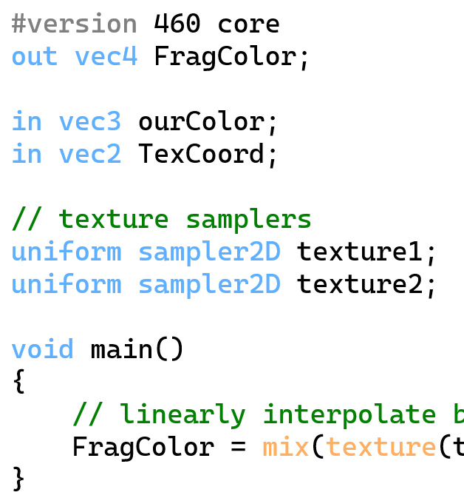
Bind Texture and Render Container
//Bind textures on corresponding texture units
//Activate the texture unit first before binding the texture
glActiveTexture(GL_TEXTURE0);
glBindTexture(GL_TEXTURE_2D, texture1);
glActiveTexture(GL_TEXTURE1);
glBindTexture(GL_TEXTURE_2D, texture2);
//Render container
glUseProgram(shaderProgram);
glBindVertexArray(VAO);
glDrawElements(GL_TRIANGLES, 6, GL_UNSIGNED_INT, 0);

Slide 40
Deallocate All Resources
//Optional: de-allocate all resources once they've outlived their purpose:
glDeleteVertexArrays(1, &VAO);
glDeleteBuffers(1, &VBO);
glDeleteBuffers(1, &EBO);

Slide 41
Update Framebuffer Size Callback Function
//Calculate the display ratio
ratio = (float)height / (float)width;
//set up vertex data (and buffer(s)) and configure vertex attributes
float vertices[] = {
//positions //colors //textures
0.5f * ratio, 0.5f, 0.0f, 1.0f, 0.0f, 0.0f, 1.0f, 1.0f, // top right
0.5f * ratio, -0.5f, 0.0f, 0.0f, 1.0f, 0.0f, 1.0f, 0.0f, // bottom right
-0.5f * ratio, -0.5f, 0.0f, 0.0f, 0.0f, 1.0f, 0.0f, 0.0f, // bottom left
-0.5f * ratio, 0.5f, 0.0f, 1.0f, 1.0f, 0.0f, 0.0f, 1.0f // top left
};
unsigned int indices[] = {
0, 1, 3, // first triangle
1, 2, 3 // second triangle
};
//Recreate the buffer data store using vertices and indices
glBufferData(GL_ARRAY_BUFFER, sizeof(vertices), vertices, GL_STATIC_DRAW);
glBufferData(GL_ELEMENT_ARRAY_BUFFER, sizeof(indices), indices, GL_STATIC_DRAW);

Slide 42
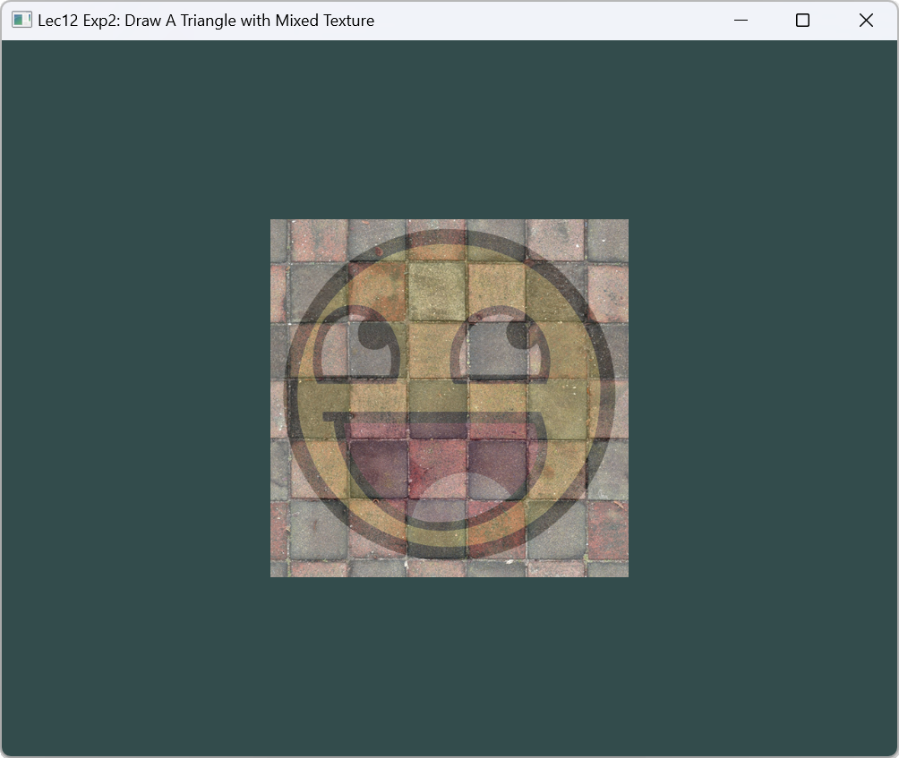
Running Result

Slide 43
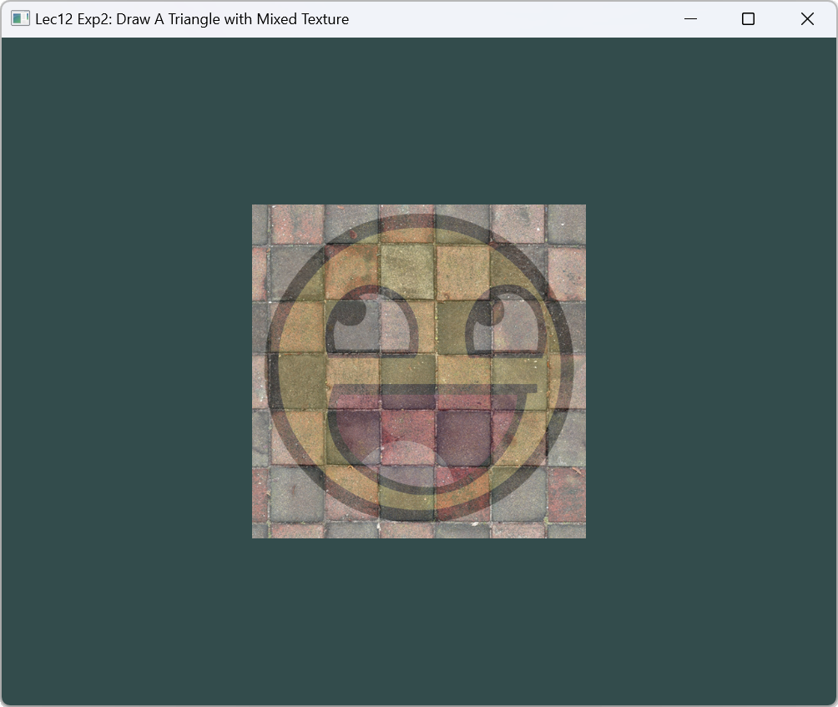
Exercise
Change the fragment shader of Exp 2, output the following result:

